Slide 1
Shared displacement data
5-20-24

Slide 2
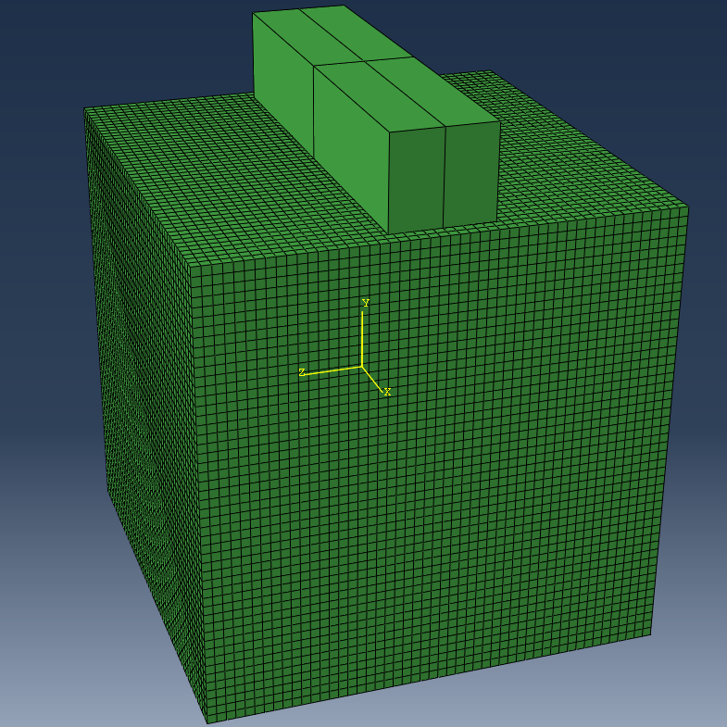
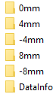
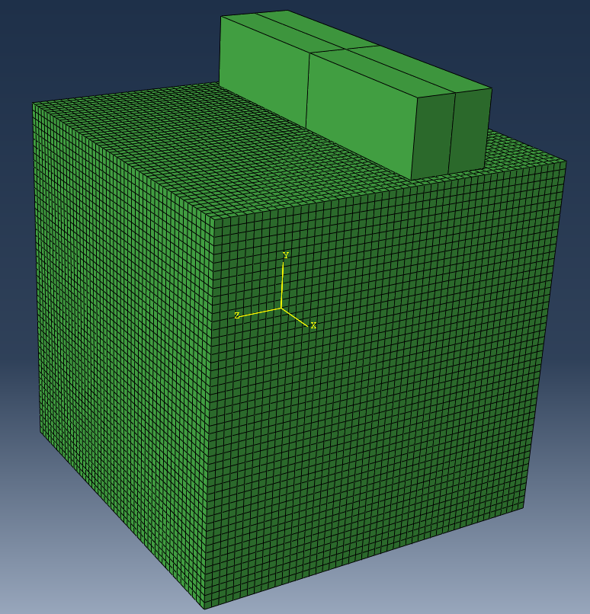



Folder outline
“0mm compression plane”
$$y$$
0 mm refers to the z-axis position where the center of the modeled probe lies.
Data from each compression plane
$$z$$
$$x$$
File info and shared data between planes
“-8mm compression plane”
Here we shifted the probe and then compressed the phantom
Probe
Phantom
Each compression plane folder contains two files: fea_displacements.mat and reaction_forces.mat
DataInfo folder contains e_map.mat and node_locations.mat
Each compression plane folder contains a separate volume of displacements that are generated using the same mesh (same node locations) and the same mechanical property distribution (same E map).

Slide 3
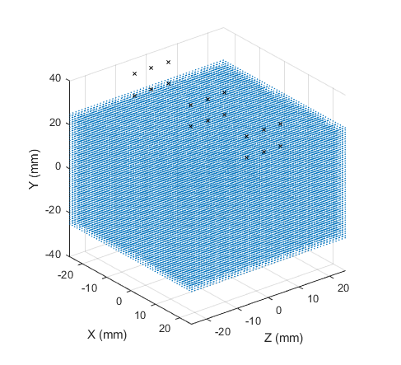



DataInfo
Node_locations.mat
All_nodes
Phantom_nodes
Probe_nodes
All_nodes contains all the node info (phantom + probe + 1 reference node)
$$y$$
x
y
z
Node #
$$z$$
$$x$$
(mm)
Probe nodes
Phantom nodes
Probe
Phantom
scatter3(phantom_nodes(:,2),phantom_nodes(:,4),phantom_nodes(:,3),2,'filled');
xlabel('X (mm)');ylabel('Z (mm)');zlabel('Y (mm)’);
hold on
scatter3(probe_nodes(:,2),probe_nodes(:,4),probe_nodes(:,3),20,'kx')
axis square
Matlab orientation is different than abaqus orientation
Phantom nodes is shared between all compression planes. Probe nodes are shifted in z (Ex: -8 for the -8mm folder…).

Slide 4
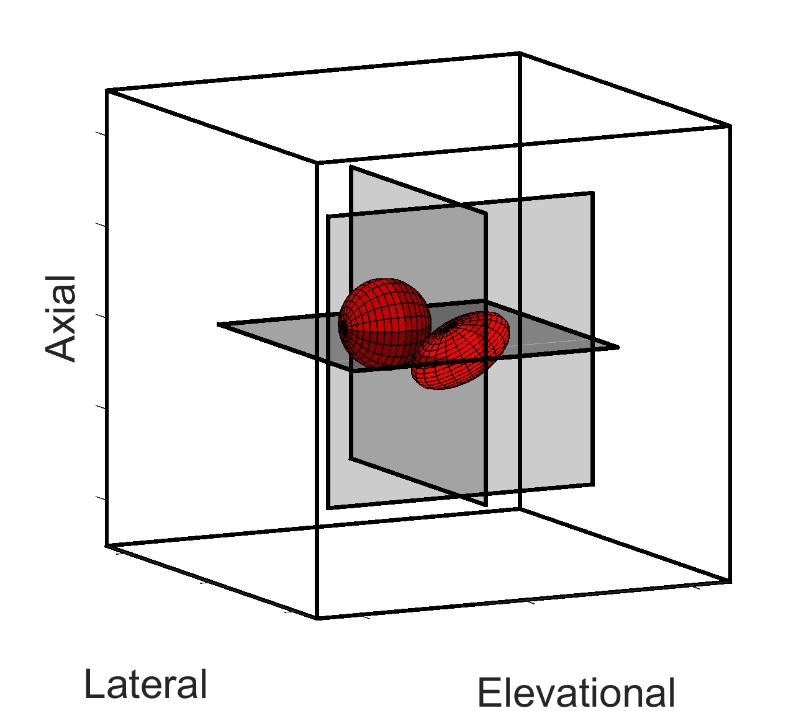
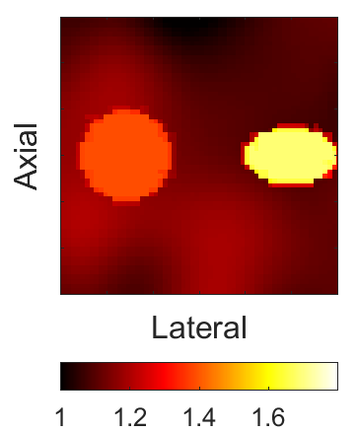



DataInfo
e_map.mat
Image Planes
Ground Truth
1
2
3
1
3
2
$$Log_{10}(E (kPa))$$
Ground Truth
Modulus is estimated at element integration points which are not uniformly distributed throughout the volume:
125000 Hex (C3D10) elements: 1,000,000 integration points
Modulus field was interpolated to an equal-spaced 3D array: 100x100x100 px over the 50x50x50 mm volume. The values in the matrix ‘e_map’ are in kPa. Poisson’s ratio was constant (0.4) over the entire volume.
Abaqus and MATLAB orientation are different. To view the volume in MATLAB’s volume viewer in the correct orientation use:
load('e_map.mat')
e_map = permute(e_map,[2,3,1]);
volumeViewer(e_map)

Slide 5











Compression info
Fea_displacements.mat
$$M×N×P$$
$$P_{1}$$
Number of load steps (3)
$$u_{x}$$
$$u_{y}$$
$$u_{z}$$
$$y$$
Node #
$$M$$
The displacement at each load step corresponds to the total displacement.
$$z$$
$$x$$
(mm)
$$P$$
$$N$$
Reaction_forces.mat: fea_rf
Same structure as fea_displacement but contains reaction forces at each node.
I provided a MATLAB script with a few blocks of code to organize and view the data for reference.

Slide 6
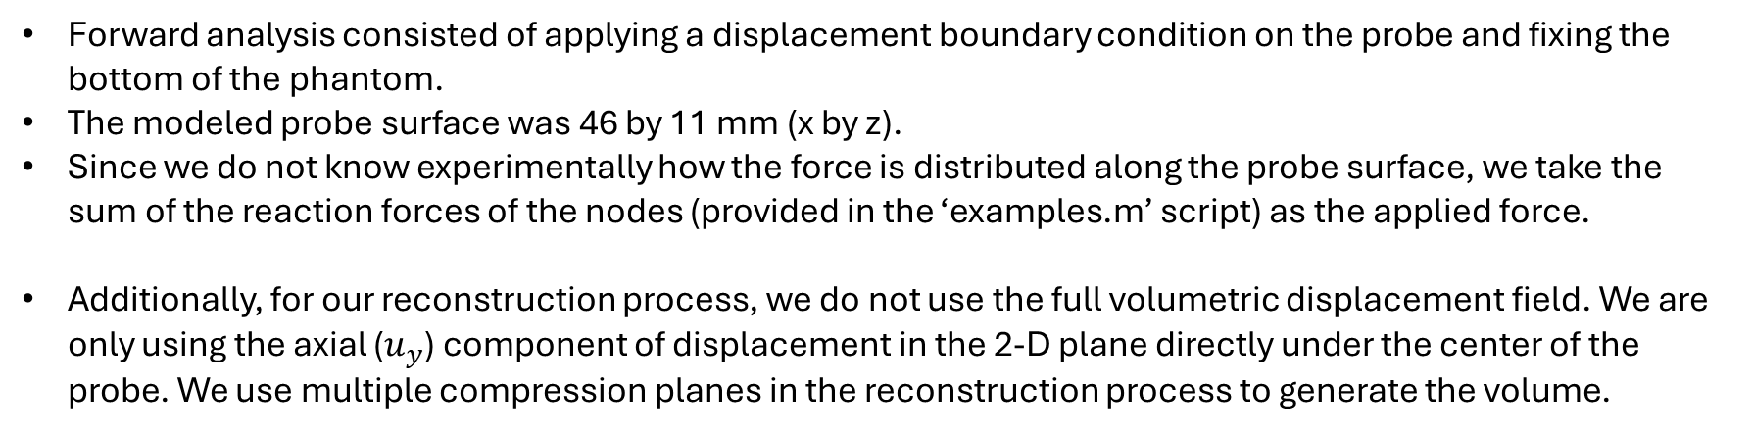
Additional Details
Forward analysis consisted of applying a displacement boundary condition on the probe and fixing the bottom of the phantom.
The modeled probe surface was 46 by 11 mm (x by z).
Since we do not know experimentally how the force is distributed along the probe surface, we take the sum of the reaction forces of the nodes (provided in the ‘examples.m’ script) as the applied force.
Additionally, for our reconstruction process, we do not use the full volumetric displacement field. We are only using the axial ($u_{y}$) component of displacement in the 2-D plane directly under the center of the probe. We use multiple compression planes in the reconstruction process to generate the volume.

Slide 7
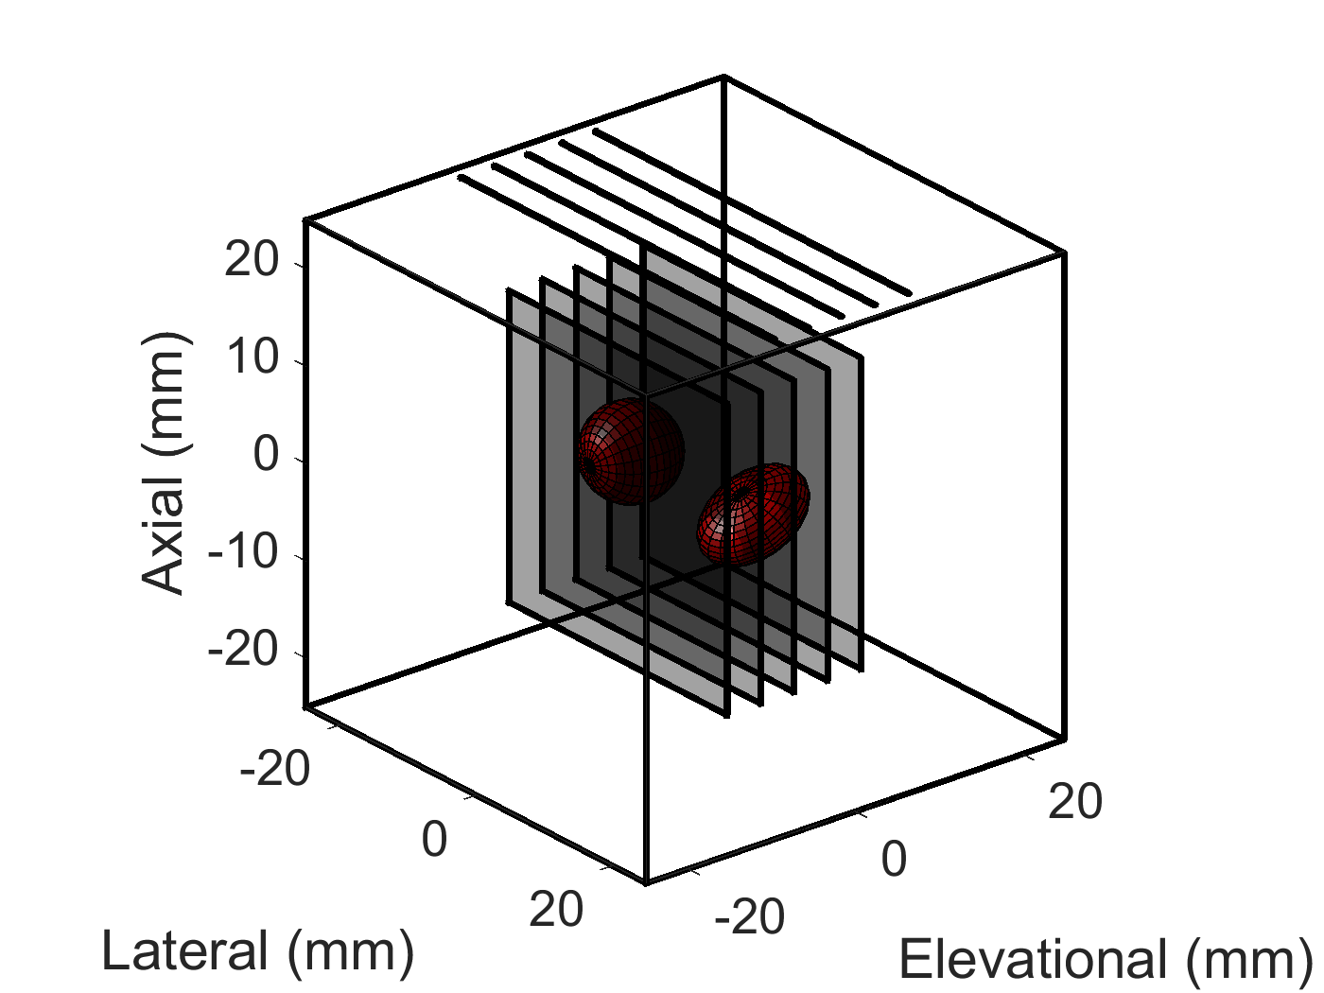







Some images from our method for comparison
5 Planes
Dynamic method:
1P – 5P
$$Log_{10}(E (kPa))$$
Images are cropped to show the central 32x32x32 mm
We take the log of the modulus image to see the background fluctuations better

